Slide 1
RPA Demo
- Cross-Platform File Syncing -

Slide 2
General Overview

Slide 3
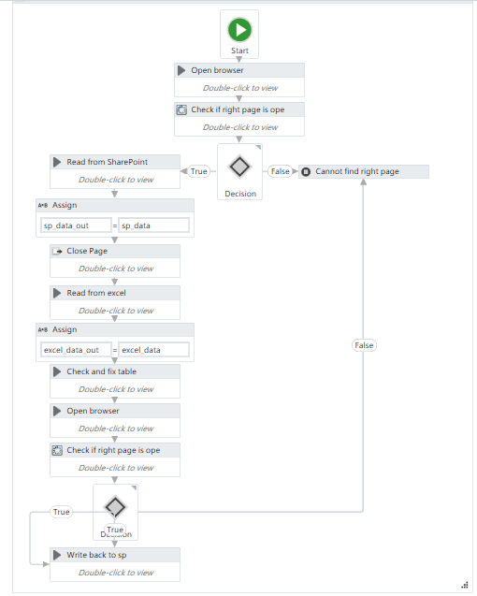
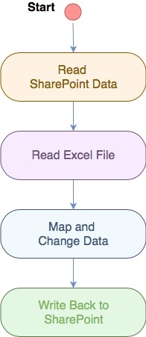

Slide 4
Main Steps

Slide 5
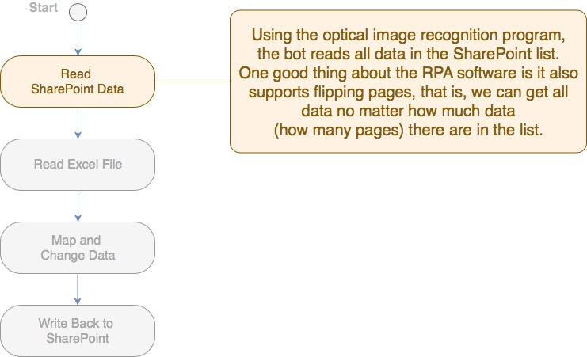

Slide 6
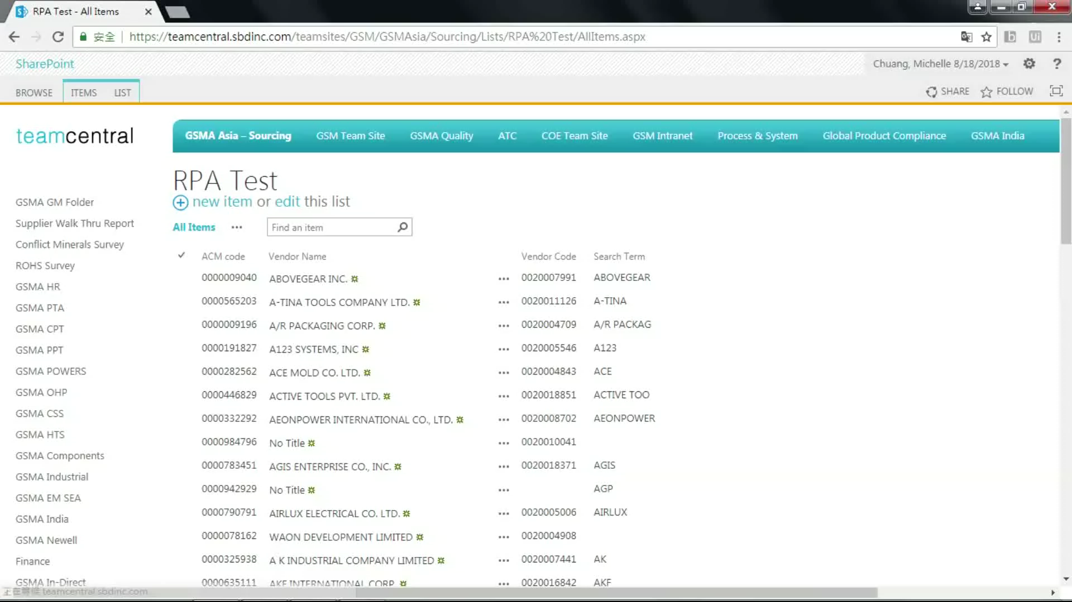
Reading from SharePoint

Slide 7
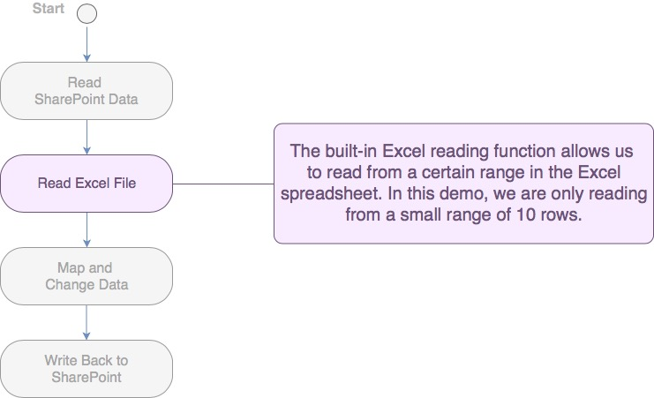

Slide 8

Reading from Excel

Slide 9
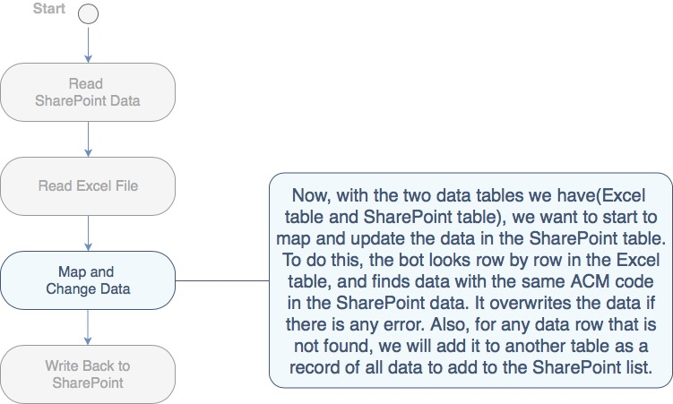

Slide 10
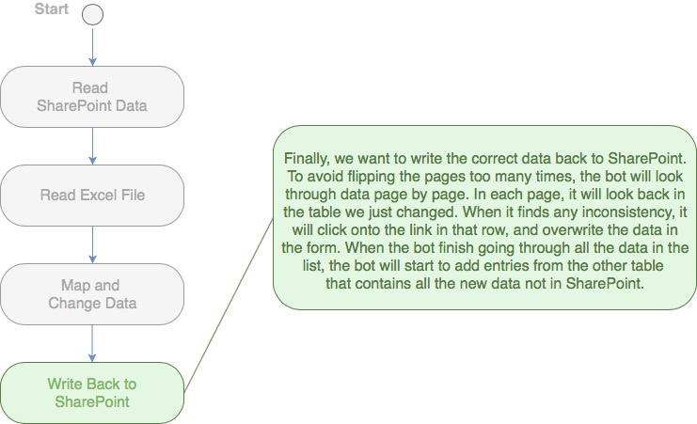

Slide 11
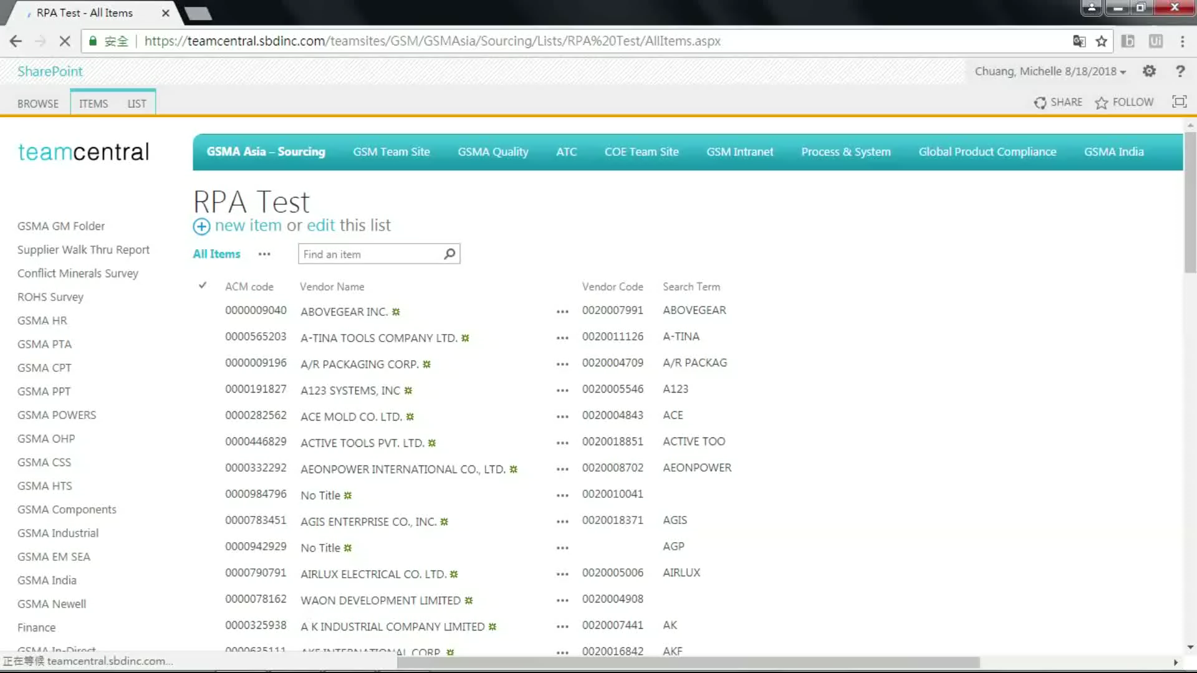
Fixing Data with Error

Slide 12
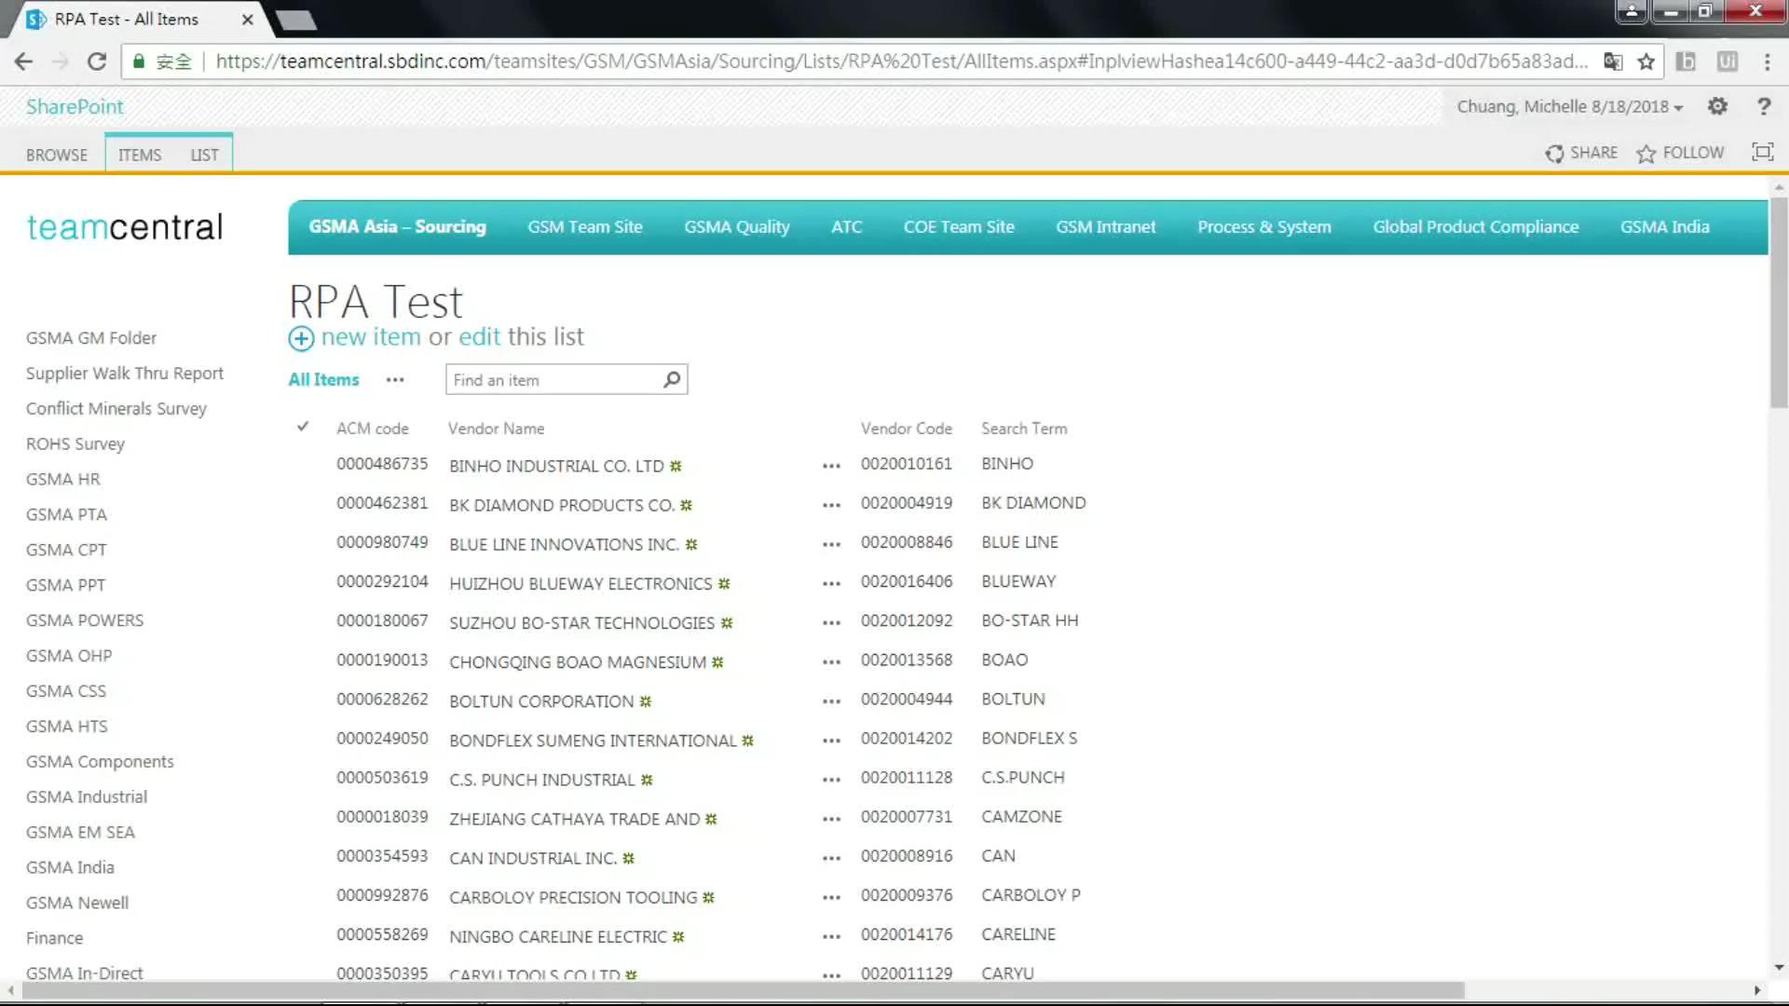
Adding New Data

Slide 13
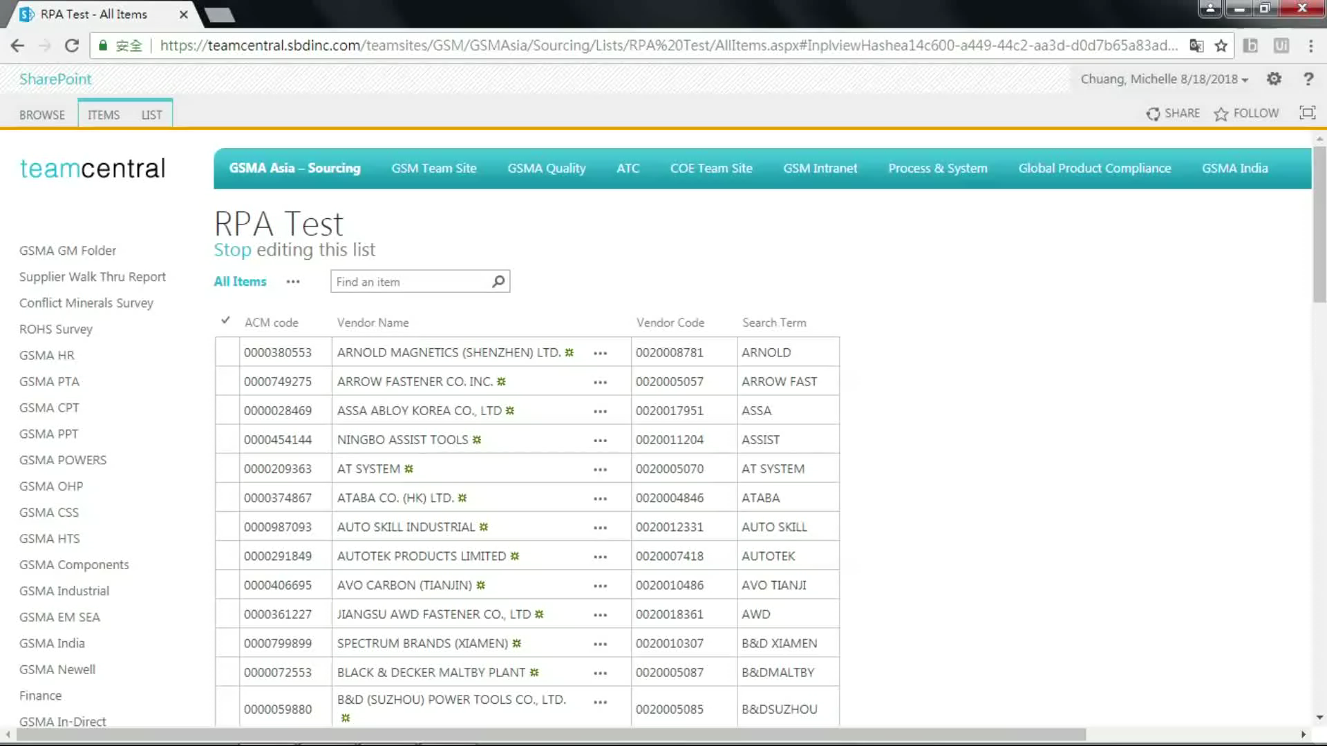
Flipping Pages to Continue Checking

Slide 14
Full Demo

Slide 15
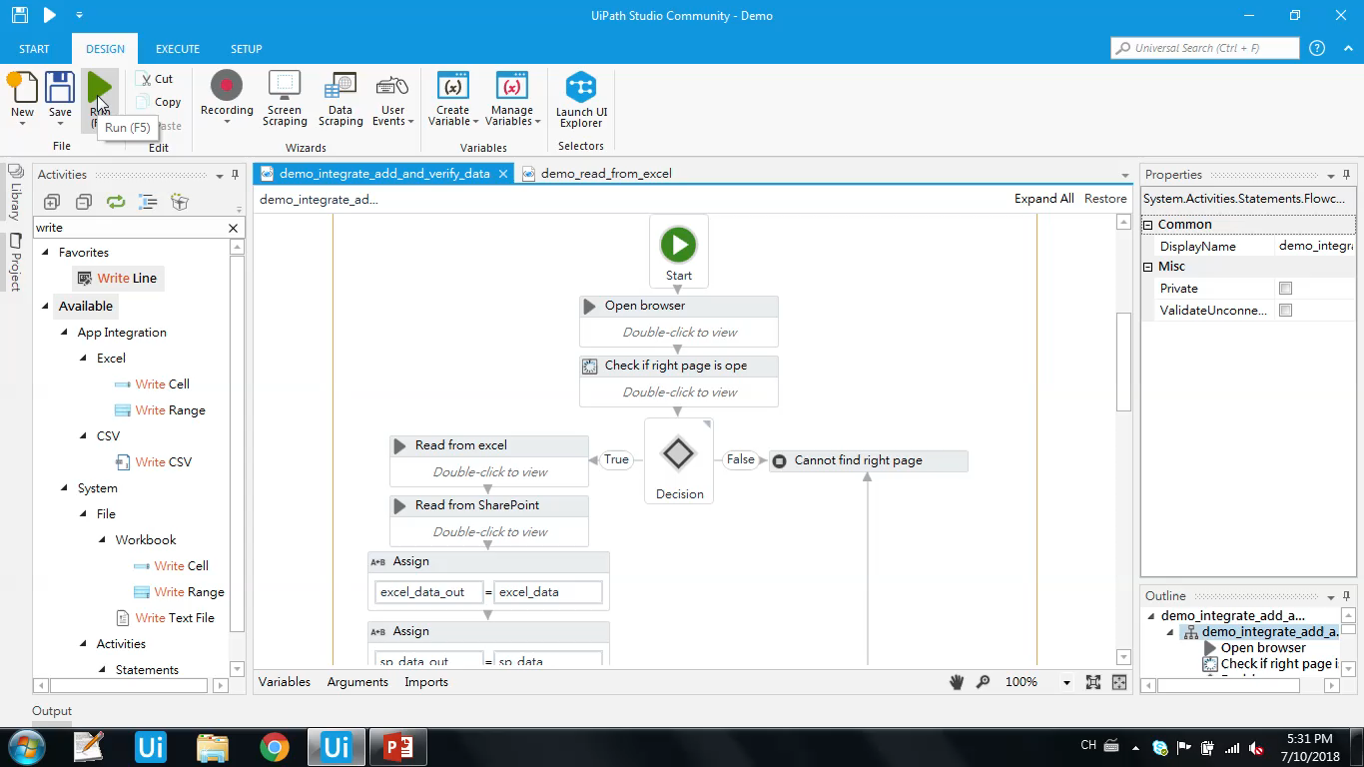

Slide 16
Conclusion
To run 100 files with around 15 errors and 15 missing data
Takes 09:26, less than 10 minutes!
Saves a lot of time and man power
Reduces error made by human
Workflow is challenging to make when:
data is not clean, or when the tables are more complicated
the person who is working on it lacks basic programming knowledge

Slide 17
The End
Thank you for listening

